Slide 1

Optimization of ticket pricing of big mountain resort
By Akshat Garg

Slide 2
Context
Yearly visit is about 350k with 105 trails.
Resort is installing an additional chair lift increasing the operating cost of $1.54 million.
No concreate data to support ticket pricing currently deployed.

Slide 3
Problem Statement
Big Mountain Resort wants to evaluate how to increase the yearly revenue by about 5% within the two season of skiing?
Can be achieved either cutting cost by closing few facilities or by increasing ticket price.

Slide 4
Recommendations and Key Findings
Our model suggests that ticket price should be about $96, an increase of about $15 from the current pricing of $81.
There are 4 scenarios:
Permanently closing down up to 10 of the least used runs.
Increase the vertical drop by 150 ft and install an additional chair lift.
Same as number 2 but adding 2 acres of snow making.
Increase the longest run by 0.2 mile and additional snow making of 4 acres to cover that.
From the model, scenario 1 and 2 are worth looking into.

Slide 5
Analysis
We analyzed the data state wise and found that state where resorts are located had no difference on pricing.
We made two models,
Linear Regression
Random Forest Regressor
During our analysis, I found that random forest regressor was performing better with a variance of $1.
This is less than just assuming mean of price of all resorts.

Slide 6
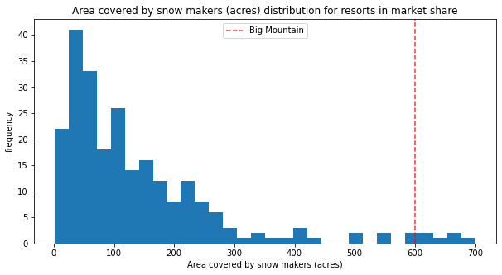
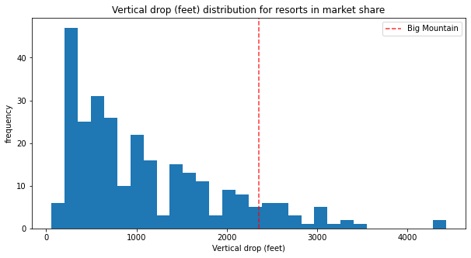
Modelling
Model found out top 4 factors which contributed the most in ticket pricing.
Fast Quad Lift
Total Runs
Snow Making per acre
Vertical drop height
In terms of Snow Making per acre and Vertical drop height Big Mountain Resort is on top of charts.

Slide 7
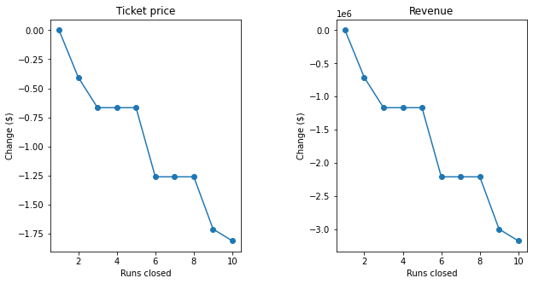
The plots in previous slide suggests that ticket pricing of $95.87 is justifiable.
Modeling Scenarios:
For scenario 1, it seems like closing up 3 to 5 runs would not have significant effect on revenue but closing anymore than that would impact revenue significantly.
For scenario 2, supported an increase in ticket pricing by $1.99. If we do so, will result in generation of $3.5 million. But this scenario does come with additional operational cost of the chair lift.
For scenario 3, it didn’t have any increase in ticket pricing when compared to scenario 2.
For scenario 4, no price increase either.

Slide 8
Summary and Conclusion
Adjusting the ticket price to $95 will provide significantly new revenue will still having about 350k people visiting.
A combination of scenario 1 and 2 can be tested by analyst for further implications on cost of operation changes.
We can further extend the model by creating UI for business analyst for easily playing with new scenarios.

